Slide 1




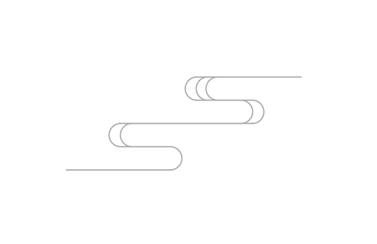
IE0015 project

Slide 2

Scenario 1 Root Cause Exploration and Overall Cost Estimation
1. We only replace the frame of the recalled bicycles
2.The salary of each employee is $20 per bicycle
3. The shipping price is the cost goes to subsidize consumers
4. We use 4M to find root cause

Slide 3
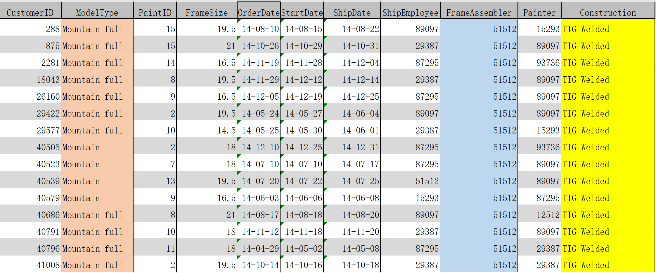
Model Type = Mountain and Mountain full
Construction = TIG Welded
Frame Assembler = 51512
Scenario 1

Slide 4
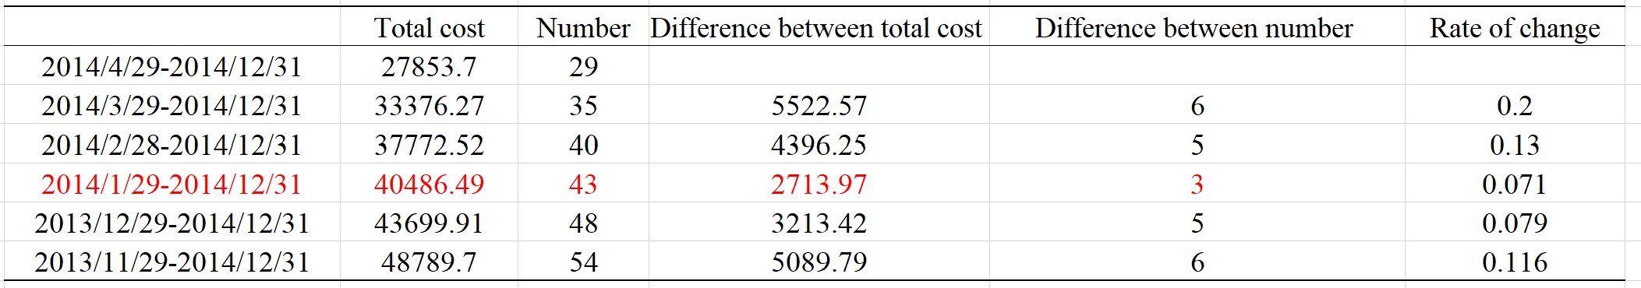

$$Cost for recall=ship fee∗2+Frame price+ Labour cost$$
Consequently, the overall estimated cost for all recalled bicycle is $40486.49
Scenario 1

Slide 5
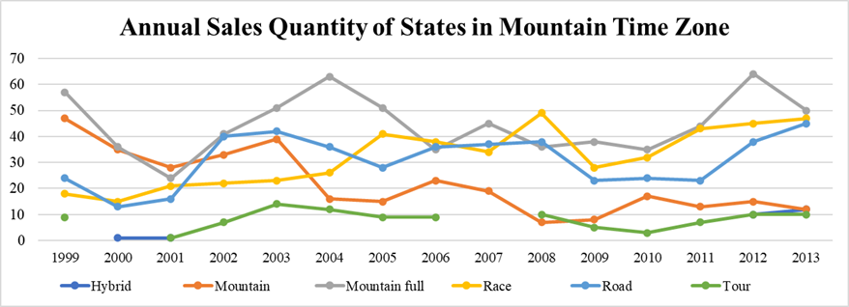
Scenario2: Sales Trend from 1998 to 2013 and Prediction
Increase the sales quantity of Race and road bicycles. Decrease sales quantity of other model types.

Slide 6
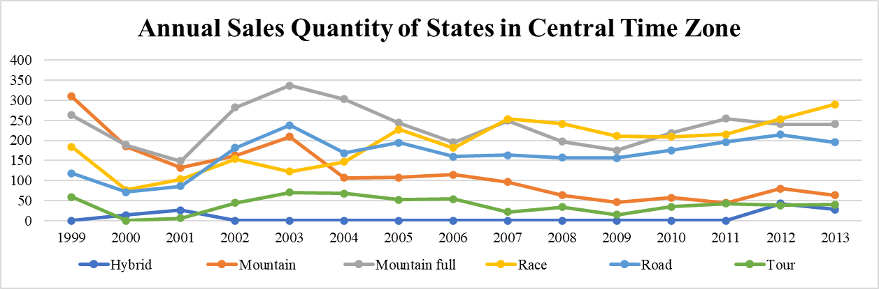
Scenario2: Sales Trend from 1998 to 2013 and Prediction
Increase the sales quantity of Race bicycles. Maintain sales quantity of mountain full and road bicycles. Decrease sales quantity of other model types.

Slide 7
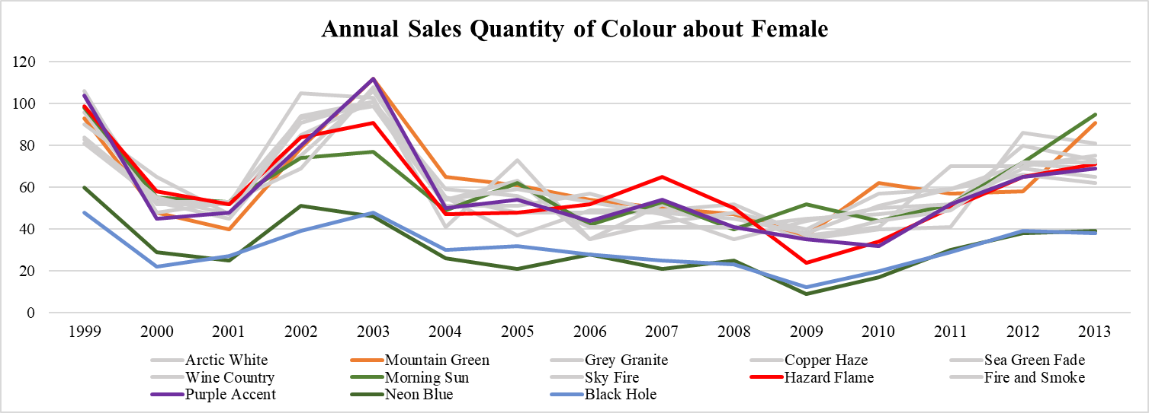
Scenario2: Sales Trend from 1998 to 2013 and Prediction
Enhance the bicycles design with bright colors, such as Purple Accent, Hazard Flame, and Morning Sun. Target women as customers and increase the popularity among female.

Slide 8
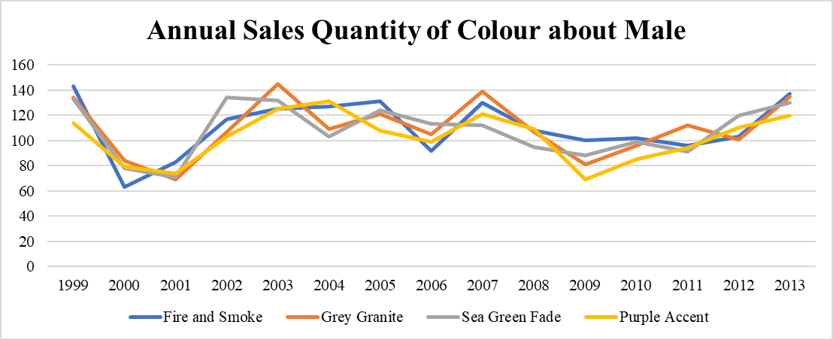
Scenario2: Sales Trend from 1998 to 2013 and Prediction
Enhance the bicycles design with dark colors, such as Fire and smoke, Grey Granite, Sea Green Fade. Target male as customers and increase the popularity among male.

Slide 9
Scenario2: Sales Trend from 1998 to 2013 and Prediction
Purple Accent
is favored by
Both male and
female
Neon Blue
Black hole
is not popular

Slide 10
Scenario 3 Range Narrowing Search for Most Likely Bicycle
Information we have already had
a. Gender: male
b. State: CA
c. Order date: 1998-now
d. Bike color: white
e. Bike Type: Rolling thunder road bike

Slide 11
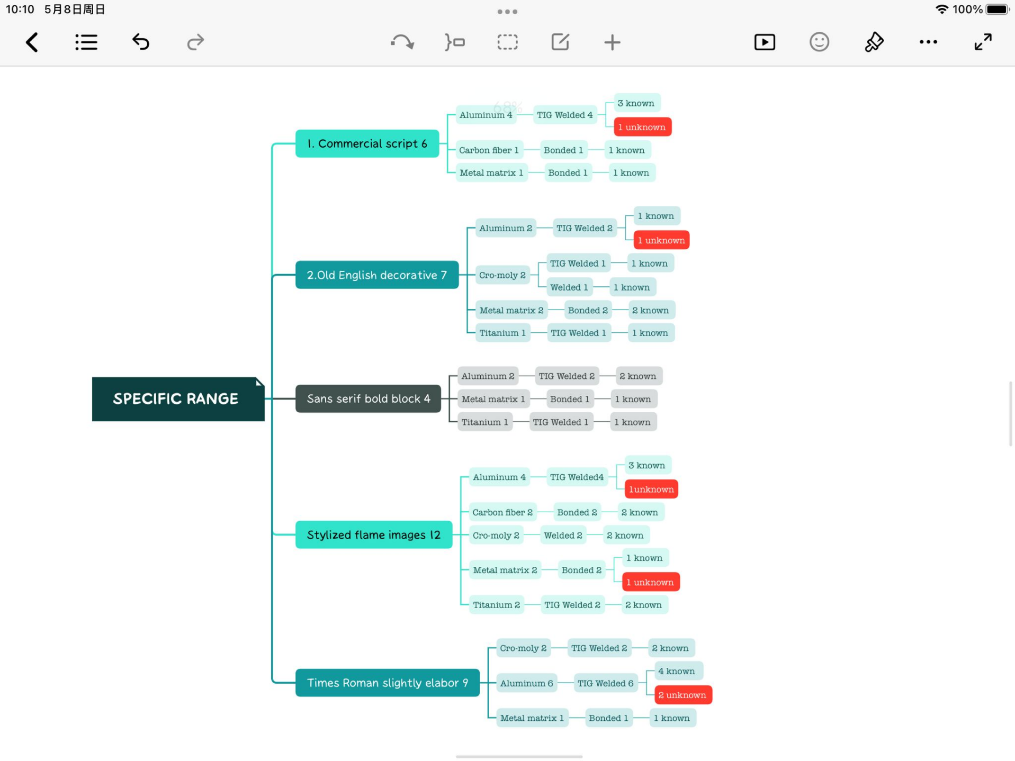
Scenario 3
Description
Material
Construction

Slide 12
Scenario 4: Application of QR model and ABC in inventory management
1. Shipping and Component cost is average of past 5 years.
2. We use 10 component to analyze, 13.57% of total cost
3. When we meet dirty data, we drop the data
4. The 8% of total estimated cost is total inventory cost
5. Service Level 95%

Slide 13
Scenario 4
Fixed cost
Salary+ Shipping cost+Component Cost=$934923.04 per year
Inventory cost
Sum ((warehouse outer amount -warehouse entry amount) *
(Component.EstimatedCost)/ (warehouse outer time -warehouse entry time)) (years)*8%=$1755701.60 per year
Lead time Now
8.69 days

Slide 14
Scenario 4 ABC classification
Inventory need to be improved!

Slide 15
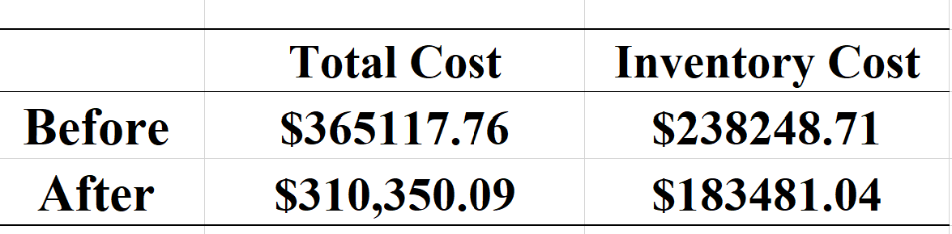
Scenario 4 Results based on QR model
(10 component chosen) Lead time=8.12 days
Cost reduced rate of total: ($365117.76-$310350.09)/ $365117.76=14.9%
Cost reduced rate of Inventory: $54767.67/$238248.71=23.5%

Slide 16
Scenario 4 Future acquisition (The second part analysis)
Material
Supplier
9.46 days
Warehouse
4.46 days
Customer
<1 day
Assembler
4.23days
1. We need the specific information of warehousing
2. We may need supplier address, warehouse rent,
detailed warehouse address and customer distribution

